Slide 1
SS ZG518- Database Design and Applications
Dr. Yashvardhan Sharma
Associate Professor, BITS-Pilani, Pilani Campus

Slide 2
What is a Database, DBMS, Database Systems?
A very large, integrated collection of structured data.
Gigabytes (2³⁰ or 10⁹), Terabytes, Petabytes
Models real-world enterprise.
Entities (e.g., students, courses)
Relationships (e.g., Mohan is taking ISC332)
A Database Management System (DBMS) is a software package designed to store and manage large databases with complex features.
Goal : Store and Retrieve database information conveniently and efficiently

Slide 3
Basic Definitions
Database System: The DBMS software together with the data itself. Sometimes, the applications are also included.
database system
database
Application
DBMS
data
catalog
e.g., the student records database system

Slide 4
Typical DBMS Functionality
Define a database: in terms of data types, structures and constraints
Construct or Load the Database on a secondary storage medium
Manipulating the database: querying, generating reports, insertions, deletions and modifications to its content
Concurrent Processing and Sharing by a set of users and programs – yet, keeping all data valid and consistent
Other features:
Protection or Security measures to prevent unauthorized access
DBMS

Slide 5
Relational DBMS
Based on a paper by Ted Codd in 1970
Queries could be expressed in a very high-level language, which greatly increases the efficiency of DB programmers
accountNo balance type
12345 1000.00 savings
67890 2846.92 checking
SELECT balance FROM Accounts WHERE accountNo=67890;
SELECT accountNo FROM Accounts WHERE type=‘savings’ AND balance<1200;

Slide 6
What is in a Database?
A database contains information about a particular enterprise or a particular application.
E.g., a database for an enterprise may contain everything needed for the planning and operation of the enterprise: customer information, employee information, product information, sales and expenses, etc.
You don’t have to be a company to use a database: you can store your personal information, expenses, phone numbers in a database (e.g., using Access on a PC).
As a matter of fact, you could store all data pertinent to a particular purpose in a database.
This usually means that a database stores data that are related to each other.

Slide 7
Database Design
ARC database:
students: names, IDNO, PRNo, …
courses: course-no, course-names, …
classroom: number, location, …
BITS
db designer 1
SWD database:
classroom: number, location, …
office: number, location, …
faculty-residence: building-no, …
student-residence: room-no, …
db designer 2

Slide 8
Is a database the same as a file?
You can store data in a file or a set of files, but …
How do you input data and to get back the data from the files?
A database is managed by a DBMS.

Slide 9
Purpose of Database Management Systems (DBMS)
Database management systems were developed to handle the difficulties caused by different people writing different applications independently.

Slide 10
Purposes of Database Systems
A DBMS attempts to resolve the following problems:
Data redundancy and inconsistency by keeping one copy of a data item in the database
Difficulty in accessing data by provided query languages and shared libraries
Data isolation (multiple files and formats)
Integrity problems by enforcing constraints (age > 0)
Atomicity of updates
Concurrent access by multiple users
Security problems

Slide 11
Data Independence
One big problem in application development is the separation of applications from data
Do I have changed my program when I …
replace my hard drive?
store the data in a b-tree instead of a hash file?
partition the data into two physical files (or merge two physical files into one)?
store salary as floating point number instead of integer?
develop other applications that use the same set of data?
add more data fields to support other applications?
… …

Slide 12
Data Abstraction
The answer to the previous questions is to introduce levels of abstraction of indirection.
Consider how do function calls allow you to change a part of your program without affecting other parts?
Main Program
function
function
data

Slide 13
Data Independence *
Applications insulated from how data is structured and stored.
Logical data independence: Protection from changes in logical structure of data.
Physical data independence: Protection from changes in physical structure of data.
One of the most important benefits of using a DBMS!

Slide 14
An Example of Data Independence
Data on disk
1129
John Law
… …
program
Program accessing data directly has to know:
first 4 bytes is an ID number
next 10 bytes is an employee name
Schema
Data on disk
1129
John Law
… …
Employee:
ID: integer
Name char(10)
DBMS
program

Slide 15
Levels of Abstraction
Many views, single conceptual (logical) schema and physical schema.
Views describe how users see the data.
Conceptual schema defines logical structure
Physical schema describes the files and indexes used.
View 1
View 2
View 3
Conceptual Schema
Physical Schema
Schemas are defined using DDL; data is modified/queried using DML.
Notes:
6

Slide 16
Example: University Database
Conceptual schema:
Students(sid: string, name: string, login: string,
age: integer, gpa:real)
Courses(cid: string, cname:string, credits:integer)
Enrolled(sid:string, cid:string, grade:string)
Physical schema:
Relations stored as unordered files.
Index on first column of Students.
External Schema (View):
Course_info(cid:string,enrollment:integer)
Notes:
7

Slide 17
Instances and Schemas
Each level is defined by a schema, which defines the data at the corresponding level
A logical schema defines the logical structure of the database (e.g., set of customers and accounts and the relationship between them)
A physical schema defines the file formats and locations
A database instance refers to the actual content of the database at a particular point in time. A database instance must conform to the corresponding schema

Slide 18
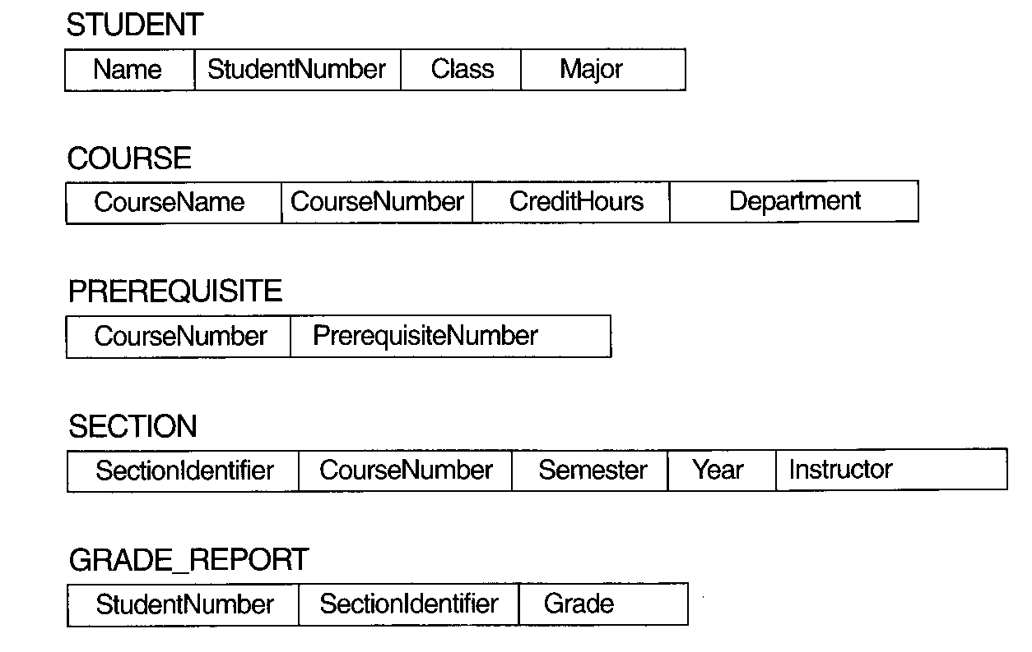
Schema diagram for UNIVERSITY database
schema construct

Slide 19
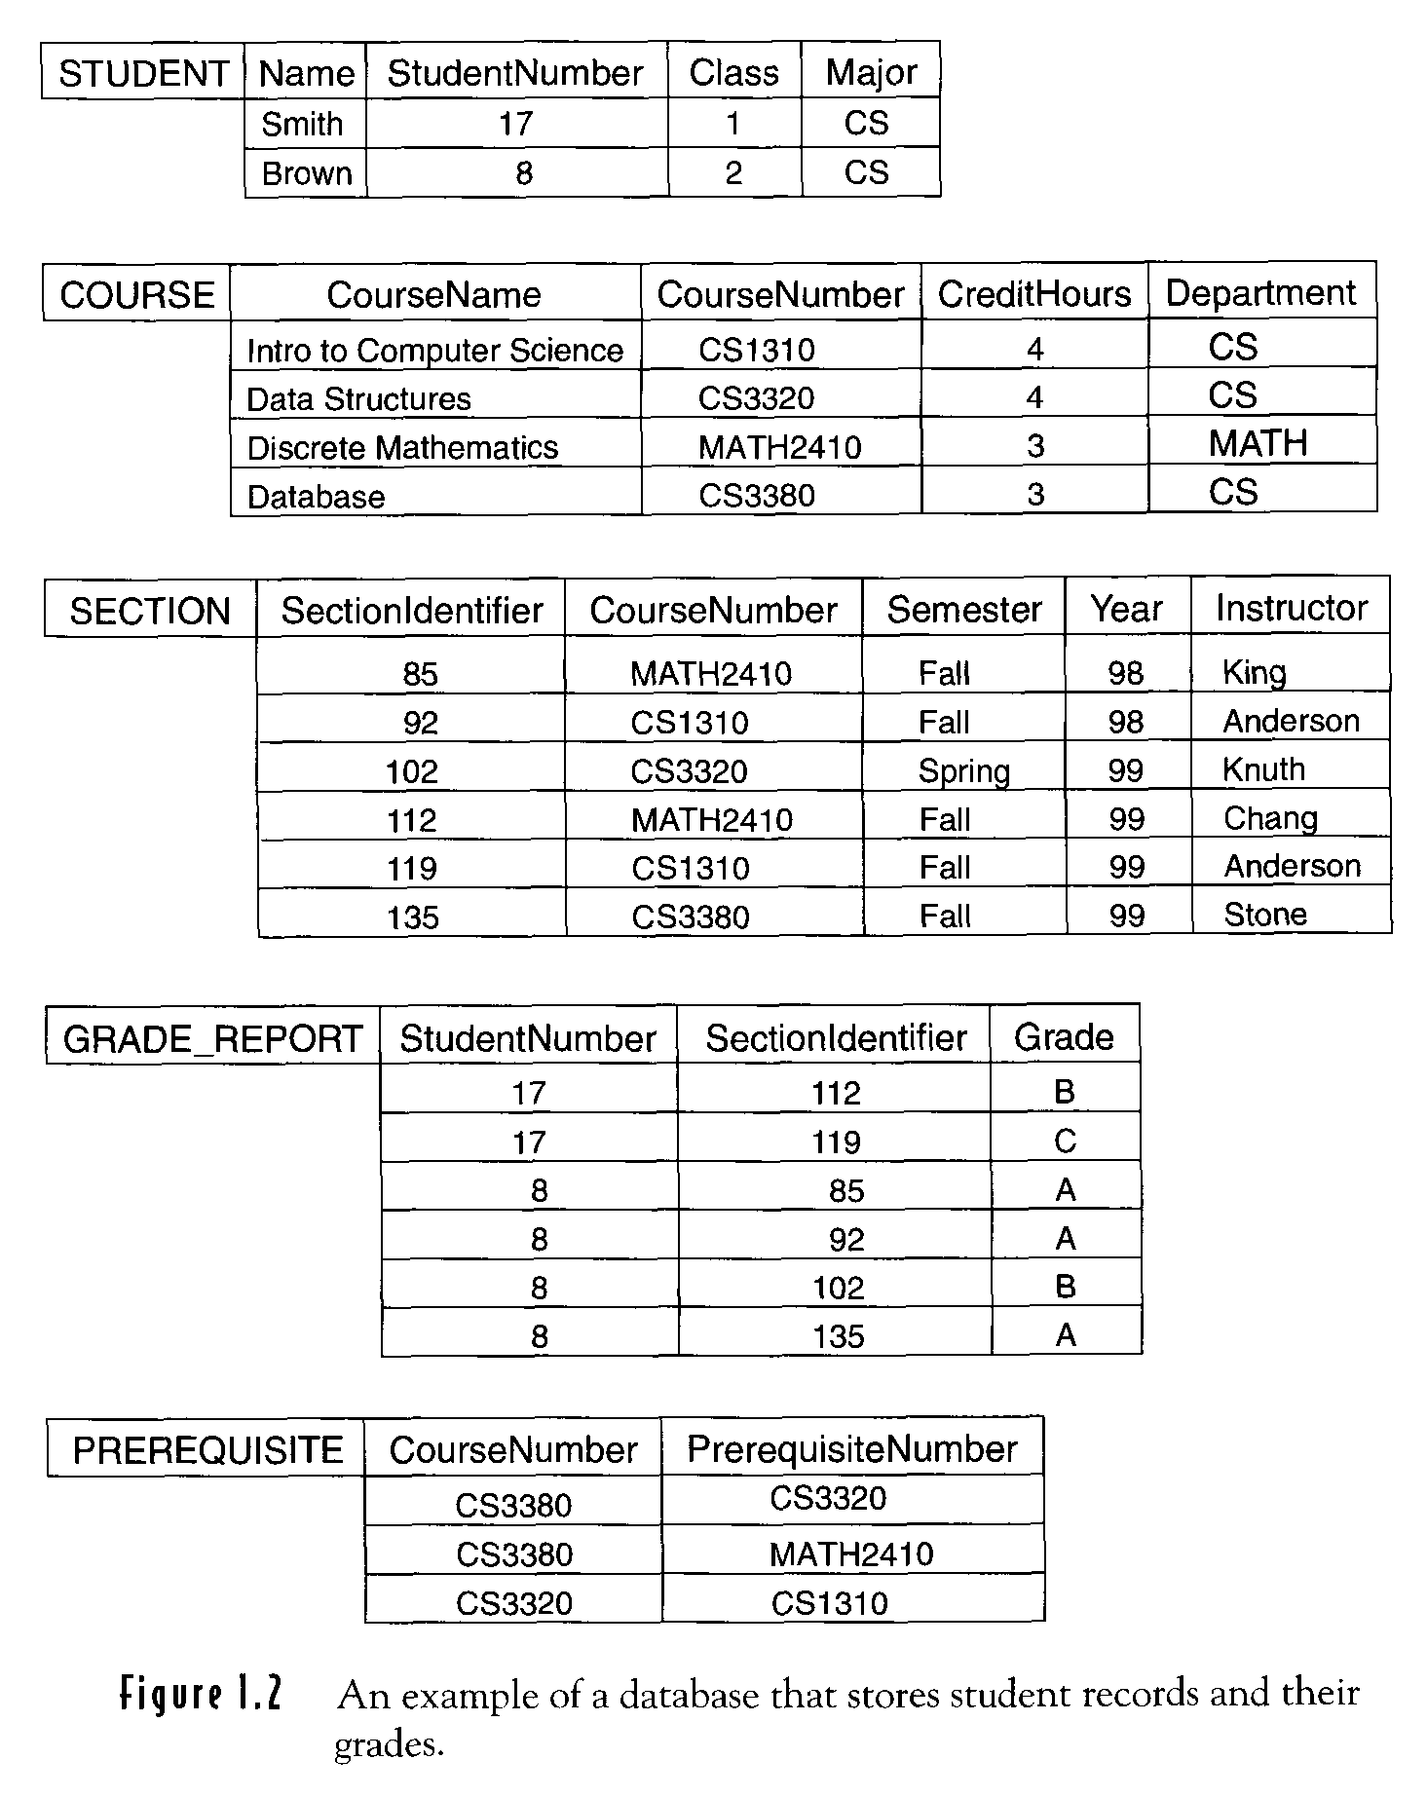
UNIVERSITY Database Instance

Slide 20
Storage Management
A storage manager is a program module that provides the interface between the low-level data stored in the database and the application programs and queries submitted to the system.
The storage manager is responsible for the following tasks:
interaction with the file manager
efficient storing, retrieving, and updating of data.

Slide 21
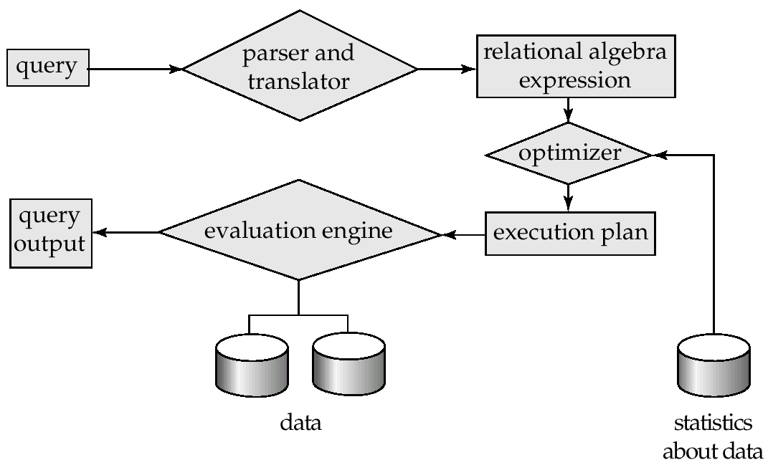
Query Processing
1. Parsing and translation
2. Optimization
3. Evaluation

Slide 22
Query Processing (Cont.)
Alternative ways of evaluating a given query
Equivalent expressions
Different algorithms for each operation
Cost difference between a good and a bad way of evaluating a query can be enormous
Need to estimate the cost of operations
Depends critically on statistical information about relations which the database must maintain
Need to estimate statistics for intermediate results to compute cost of complex expressions

Slide 23
Transaction Management
A transaction is a collection of operations that performs a single logical
function in database application
time
Transaction 1
Transaction 1
Transaction 2
Conflicting read/write

Slide 24
Transaction Management (cont.)
Transaction-management component ensures that the database remains in a consistent (correct) state despite system failures (e.g. power failures and operating system crashes) and transaction failures.
Concurrency-control manager controls the interaction among the concurrent transactions, to ensure the consistency of the database.

Slide 25
Database Administrator (DBA)
Coordinates all the activities of the database system; the database administrator has good understanding of the enterprise’s information resources and needs.
Database administrator’s duties include:
Schema definition
Specifying integrity constraints
Storage structure and access method definition
Schema and physical organization modification
Granting user authority to access the database
Monitoring performance and responding to changes in requirements
Primary job of a database
designer
More system
oriented

Slide 26
Database Users
Users are differentiated by the way they expected to interact with the system
Application programmers
Develop applications that interact with DBMS through DML calls
Sophisticated users
form requests in a database query language
mostly one-time ad hoc queries
End users
invoke one of the existing application programs (e.g., print monthly sales report)
Interact with applications through GUI

Slide 27
Structure of a DBMS
These layers
must consider
concurrency
control and
recovery
A typical DBMS has a layered architecture.
The figure does not show the concurrency control and recovery components.
This is one of several possible architectures; each system has its own variations.
Query Optimization
and Execution
Relational Operators
Files and Access Methods
Buffer Management
Disk Space Management
DB
Notes:
22

Slide 28
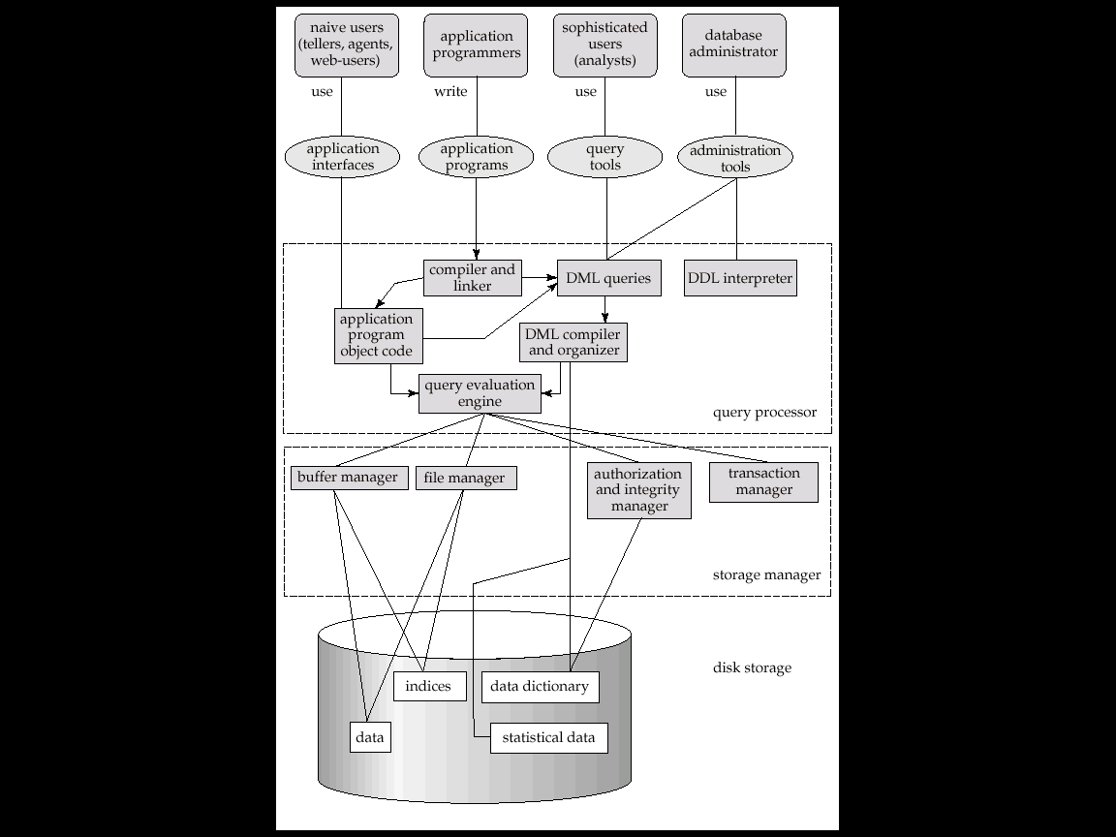
Overall System Architecture

Slide 29
User / Application
Transaction Commands
DB Administrator
DDL Commands
Query Compiler
Transaction Manager
DDL Compiler
Query plan
Execution Engine
Logging & Recovery
Concurrency Control
Index, file and record requests
Meta data
Statistics
Meta data
Index/file/record manager
Log pages
Lock
Table
Page Commands
Data, metadata,
indexes
Buffer Manager
BUFFERS
Read/writepages
Storage Manager
Architecture of Modern DBMS

Slide 30
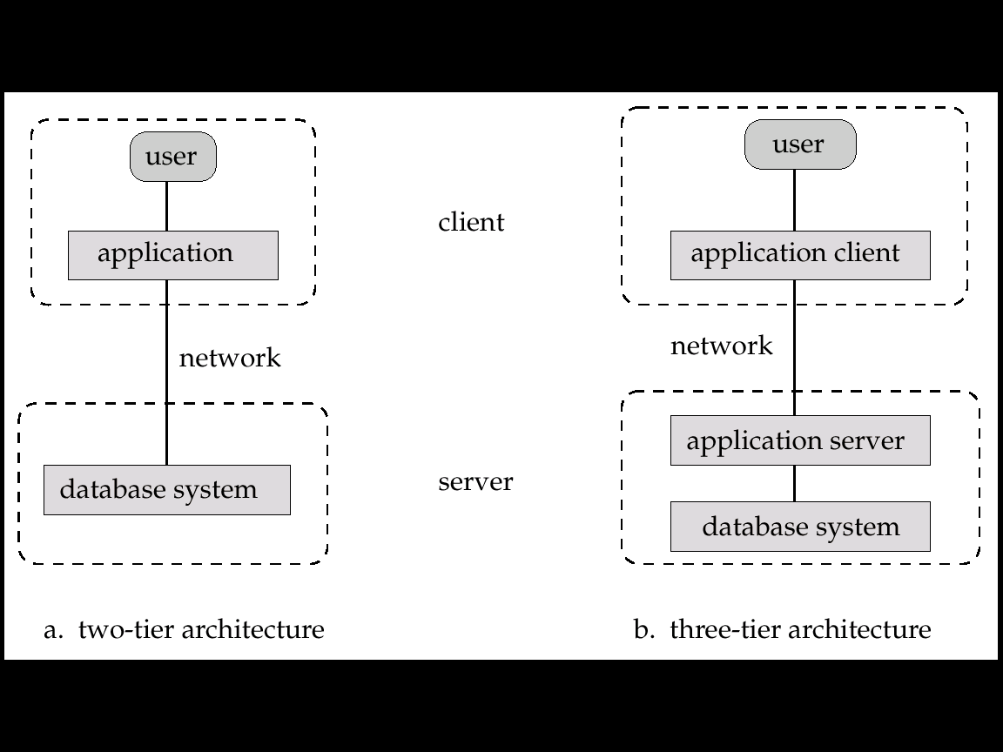
Application Architectures
Two-tier architecture: E.g. client programs using ODBC/JDBC to communicate with a database
Three-tier architecture: E.g. web-based applications, and applications built using “middleware”

Slide 31
Characteristics of a Modern DBMS
Data independence and efficient access.
Abstraction - hiding lower level details
Efficient data access
Indexing - Significant for very large databases
Data integrity and security
Application independent data integrity features
Simpler Access control mechanisms - Views
Uniform data administration.
Concurrent access, recovery from crashes.
Reduced application development time
Many important tasks are handled by DBMS
Notes:
3

Slide 32
Summary
DBMS used to maintain, query large datasets.
Benefits include recovery from system crashes, concurrent access, quick application development, data integrity and security.
Levels of abstraction give data independence.
A DBMS typically has a layered architecture.
DBAs hold responsible jobs and are well-paid! ☺
DBMS R&D is one of the broadest, most exciting areas in CS.

